Slide 1
Intro to Mobile App Development in Using Android
FINAL PROJECT

Slide 2
Phone-Brain Interface for Real-Time EEG visualization and Cognitive State monitoring
Zijing mao
Abdurrahman akuzum
Lenis Mauricio meriño

Slide 3
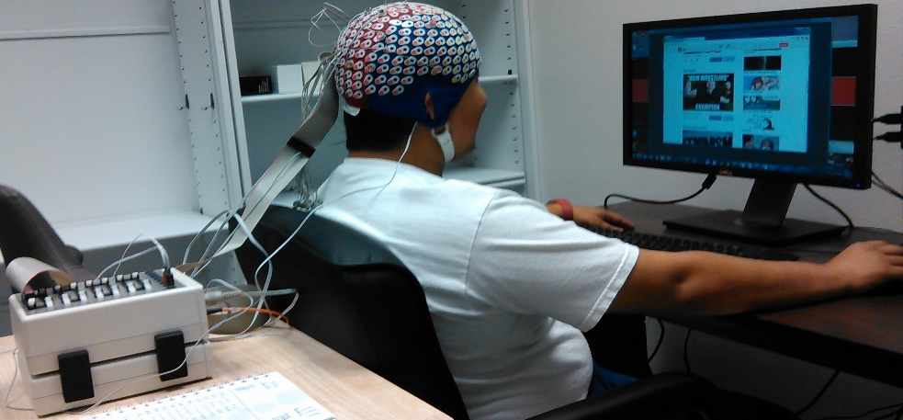
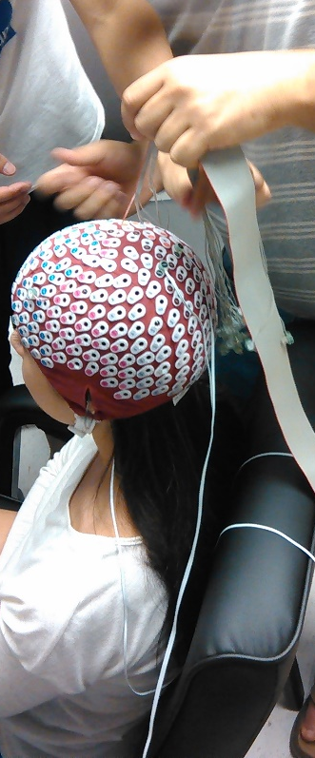
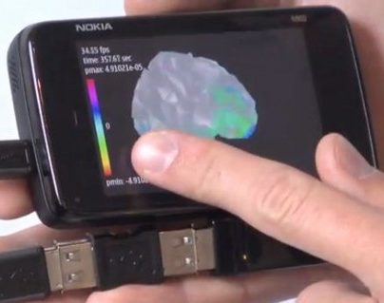
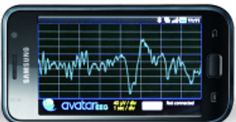
Motivation: EEG and BCI
EEG (Electroencephalogram) Simple, cheap and reliable method to record brain signals at the user’s scalp.
EEG is simple and cheap and the most used method to study the brain inner mechanics.
EEG used also for disease diagnosis, treatment, cognitive state, emotions, memory, learning, etc.
BCI (Brain-Computer Interface) Uses brain-signals to communicate a message or control an external device, highly active research area (medical, commercial, military, entertainment, etc.)
Active BCI (direct control), Reactive BCI (uses natural reaction to stimulus), Passive BCI (unnoticed monitoring of awareness/focus/emotion/drowsiness, etc.)
UTSA is highly engaged into BCI research, mobile applications is a novel and fairly-explored approach.
Mobile advantages: for Cost, Portability, Mobility, Realistic/Complex experiment and applications.

Slide 4
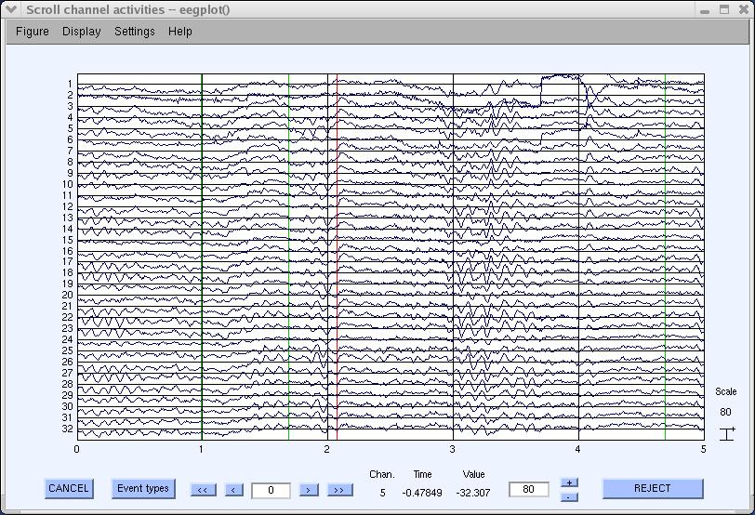
EEG Data: Sample

Slide 5
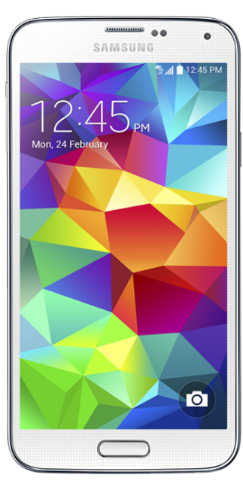
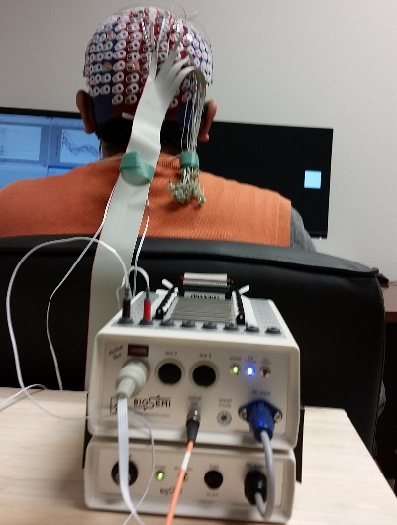

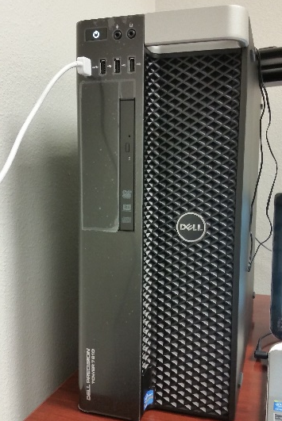
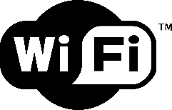

Android Phone-Brain Interface: How it works?
PBI Client Software (Java)
Connect to PBI Server (Phone)
LSL Data Receiver (Java)
Send EEG Data as OutputObjectStream
IN
OUT
IN
OUT
LSL BioSemi App
(C++)
EEG Data … EEG Data … EEG Data … EEG Data … EEG Data … EEG Data
EEG Inlet => Client-independent continuous transmission of data
Process A
Process B

Slide 6
Android Phone-Brain Interface: Activity design
Home Activity
About US
Activity
Help Activity
Donate
Activity
EEGVis
Activity
Data
Analysis
Activity

Slide 7
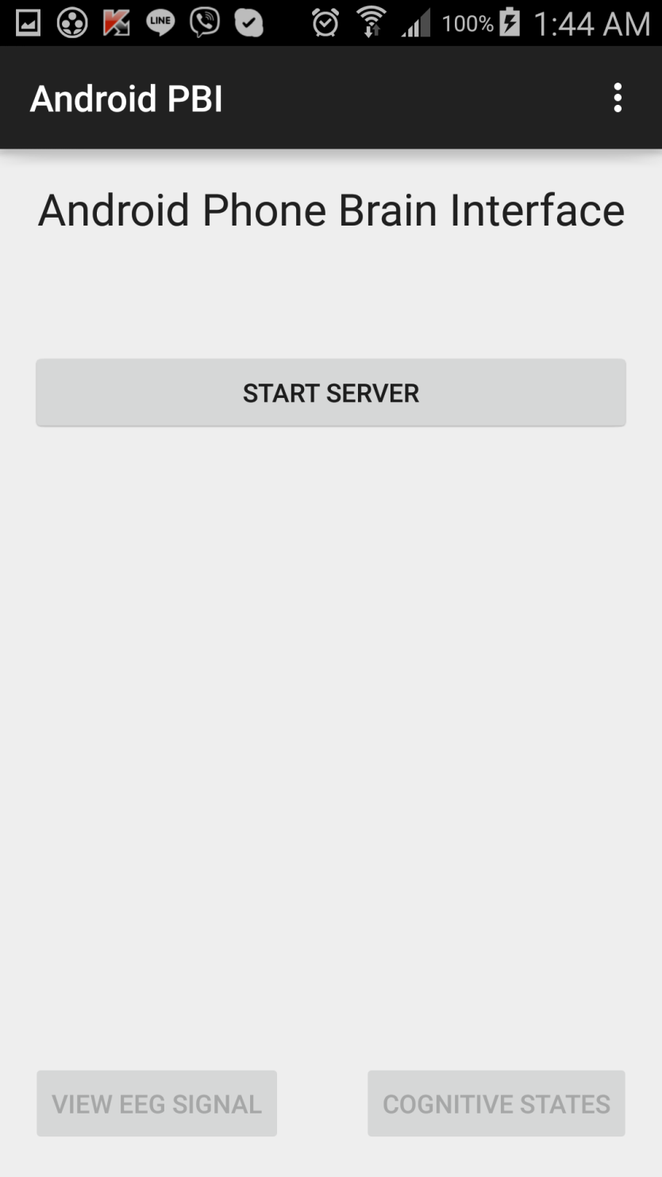
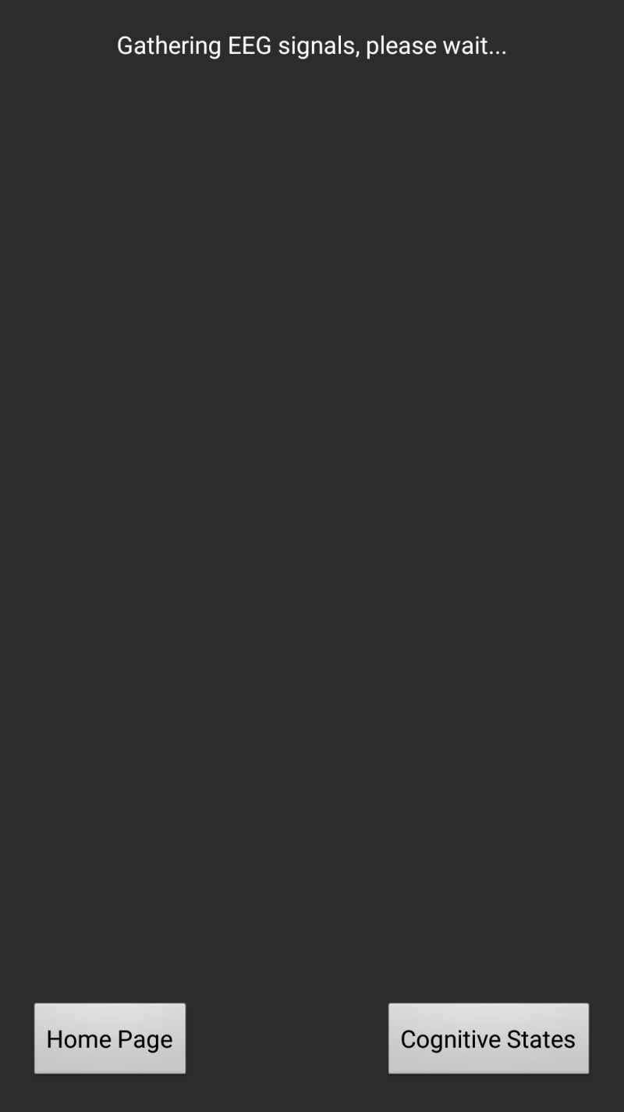
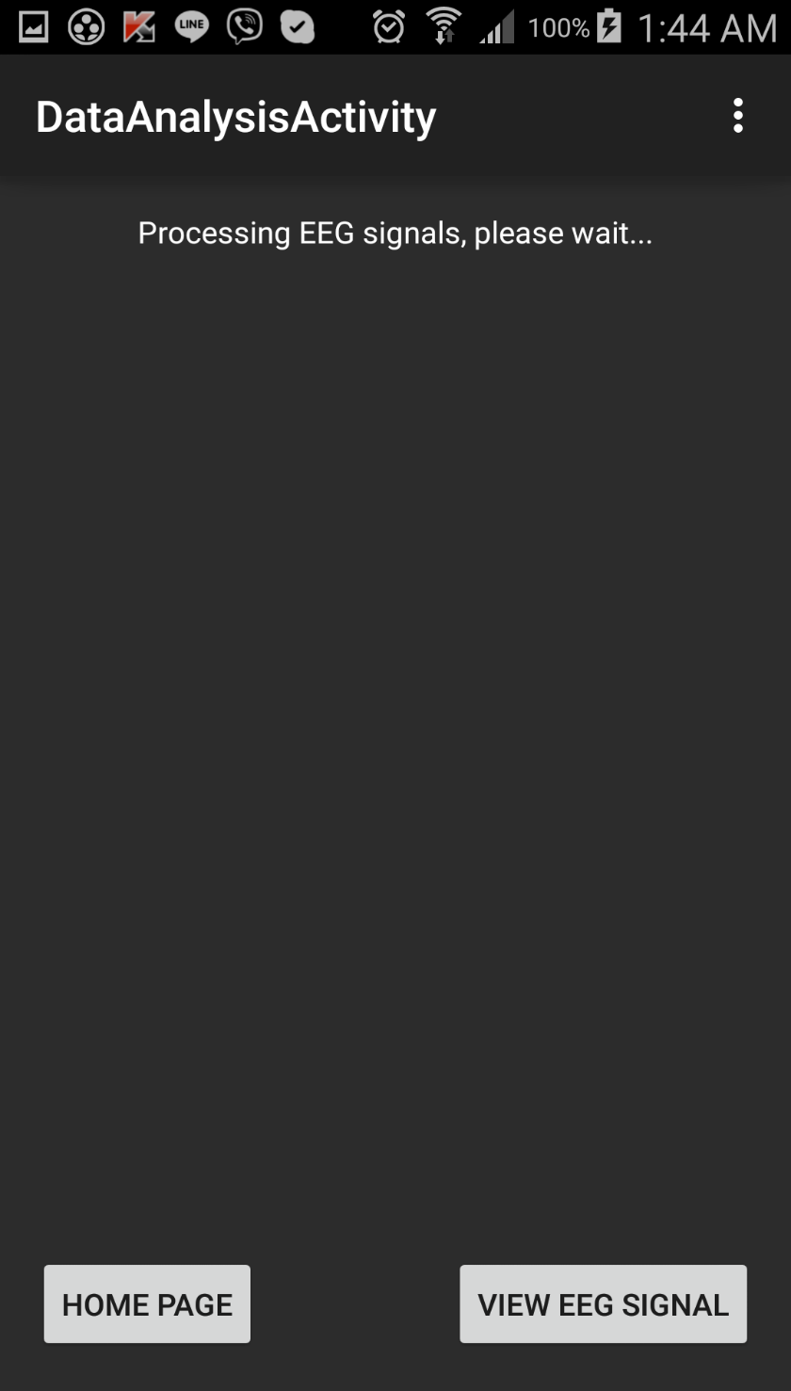
Android Phone-Brain Interface: Activity design

Slide 8
Android Phone-Brain Interface: Programming Design
Home Activity
Configure Layout
EEGVis Activity
Data Analysis Activity Activity
Check Internet Connection
Override Methods
Buttons Callbacks
Save/Restore activity state (server flags)
Create and Start EEG Service
Intents to go to other activities
EEG Service
Configure Layout
Override Methods
Receive EEG data from Service (Broadcast Receiver)
Intents to go to other activities
Configure Layout
Override Methods
Buttons Callbacks
Receive EEG data from Service (Broadcast Receiver)
Update real-time EEG Plot
Intents to go to other activities
Override Methods
Receive request from Client
Extract EEG multi-channel sample from Object
Broadcast EEG sample
Apply FFT (frequency domain)
Compute the powers for each Brain Band
Buttons Callbacks
Update real-time EEG Plot
Broadcast power values per band

Slide 9
FUTURE WORK
Improve the system.
Improve sampling rate
Add more visualization capabilities
Add more Passive BCI monitoring
Let this PBI be known among the UTSA community and collaborators from other university
Perform intensive testing
Share the code so other people can use the PBI

Slide 10
Demonstration – See Video Demo

Slide 11
Q&A Thanks!

